Slide 1


SEM – VI 2022-23 TY A EDI II Presentation on “abhayadipti” ~ Empowering SAFETY AND EFFICIENCY : HARNESING IOT COAL MINE MONITORING AND ALERTS
JSPM’s
RAJARSHI SHAHU COLLEGE OF ENGINEERING
Department of Electronics and Telecommunication Engineering

Slide 2
JSPM’s
RAJARSHI SHAHU COLLEGE OF ENGINEERING
Department of Electronics and Telecommunication Engineering
“ IOT Based coal mine safety monitoring and alerting system ” By Rutuja Bothe Mayuri Kale Siddhi Sarote Under the guidance of Dr.P.M.Ghate

Slide 3
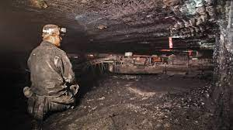
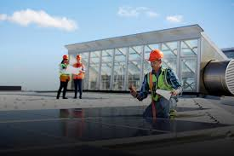
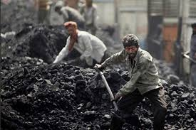
Index
Introduction
Findings from Literature Survey
Aim & Objectives
Applications, Advantages and Limitations
Expected outcome
Experimentation and results
Conclusion
References

Slide 4
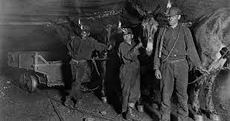
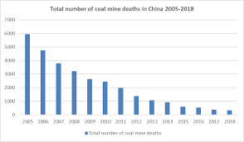
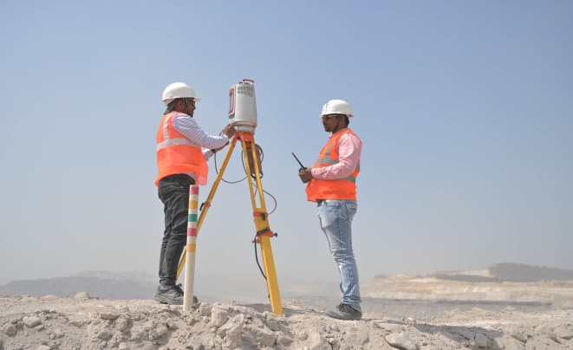
Objectives
The main objective is to create a safer working environment, prevent accidents, improve response times, and facilitate data-driven decision-making for continuous safety enhancements.
To give a solution to design smart work clothing that has sensors embedded in it to securely transmit data to managers about hazardous conditions improving safety overall.

Slide 5
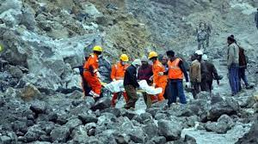
Introduction
With the emergence of Industrial Internet of Things (IoT) a smart safety jacket is developed which will monitor and also provide precautionary measures for miner’s safety using concept of IoT.
Integrating smart safety jackets with different health sensors such gas sensor, carbon monoxide sensor, air quality sensor, smoke sensor, wifi module, temperature and humidity sensor.
Sensors constantly send the sensor data to the cloud and if any abnormal situation occurs it will send a message to the responsible person in the control room as well as it will alert the miners.
As, mining take place deep underground it can be more vulnerable to toxic gases, low oxygen level, hazardous gases can be detected with MQ gas sensor family.
The developed system is mainly implemented to improve the working condition inside the coal mines and also to ensure workers safety.

Slide 6
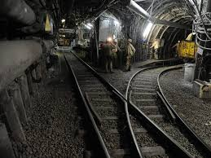
Findings From Literature Survey
Research so far in the area of safety has revealed that the majority of incidents in this hazardous industry take place because of human error, the control of which would enhance safety levels in working sites to a considerable extent. India is the world's second-largest coal producer as of 2021.
Coal production in the country stood at 715.95 million tons (MT) in FY21. Between April 2021 and October 2021, coal production in India stood at 379.597 million tons (MT). Coal is the main pillar of India’s energy sector. In 2021, it said, India consumed 93.2 crore tons of coal, 77% of which came from domestic production
The National Foundation of India study said that crores of Indians depend on the coal economy directly or indirectly. It highlighted that more than 1.3 crore Indians are employed in coal mining. Mining workers are affected by many hazards – from ventilation problems, mine flooding, gas explosions, ceiling collapsing, spontaneous combustion, to un-optimized evacuation routes.
Mining workers are affected by many hazards – from ventilation problems, mine flooding, gas explosions, ceiling collapsing, mine haulage, sudden inrushes and mine inundation, spontaneous combustion, to un-optimized evacuation routes. And mine operators have been working for decades to ensure no fatal accident results in death, injury, or poor health of miners.

Slide 7
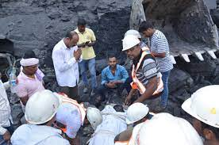
Advantages And Disadvantages
Advantages
Reduced Downtime: With continuous monitoring and early detection of hazards, the system helps minimize downtime due to accidents or safety issues. By preventing accidents or quickly addressing them, the system contributes to uninterrupted mining operations and increased productivity.
Worker Well-being: By creating a safer working environment, the system contributes to the overall well-being of miners. It reduces occupational risks, enhances physical safety, and promotes a positive work environment, leading to improved morale and increased job satisfaction.
Disadvantages
Initial Cost: Implementing an IoT-based system requires a significant upfront investment in sensors, infrastructure, networking, and software. The cost of setting up the system may pose a challenge, particularly for smaller mining operations with limited budgets.
User Acceptance and Training: Introducing a new technology like IoT-based monitoring systems may face resistance or skepticism from mine operators and workers.

Slide 8
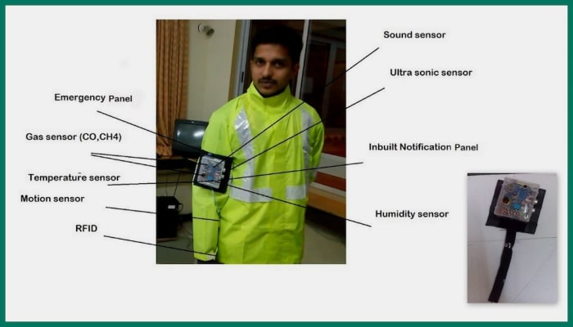
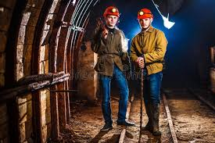
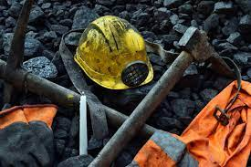
Results
Real-time Monitoring: The system successfully provided real-time monitoring of various environmental parameters, including methane concentration, temperature, humidity, air quality, and structural integrity. The data collected by the sensors was accurate and reliable.
Early Warning System: The system effectively detected potential safety risks and issued timely alerts to the relevant personnel. This allowed for prompt action to be taken, reducing the likelihood of accidents or hazardous situations.
Improved Response Time: By providing instant alerts, the system significantly improved the response time of the mine operators and workers. They could quickly assess the situation and take appropriate measures to mitigate risks.

Slide 9
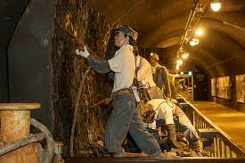
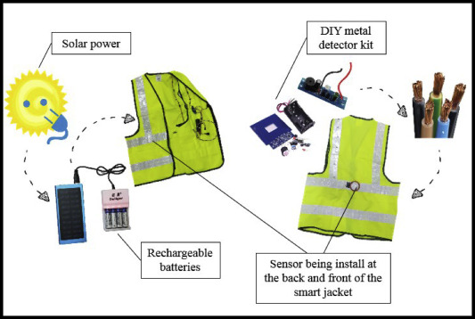
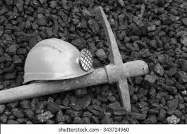
Conclusion
By providing real-time monitoring of hazards, timely alerts and warnings, location tracking, and remote monitoring capabilities, the system enables proactive measures to prevent accidents, facilitates quick response during emergencies, and enhances overall safety within coal mines.
Additionally, the system supports data analysis for insights, predictive maintenance, and training purposes, contributing to continuous improvement and optimized safety protocols.
Despite certain limitations, the implementation of an IoT-based coal mine safety monitoring and alerting system is a valuable investment in protecting the lives and well-being of miners while enhancing productivity and regulatory compliance

Slide 10
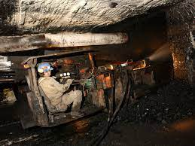
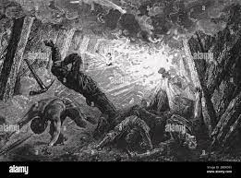

References
Research Paper 1 : https://ieeexplore.ieee.org/document/9971919
2. Smart India Hackathon Problem Statement : https://sih.gov.in/sih2022PS?technology_bucket=QWxs&category=SGFyZHdhcmU=&organization=QWxs&organization_type=QWxs

Slide 11
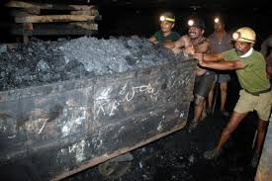
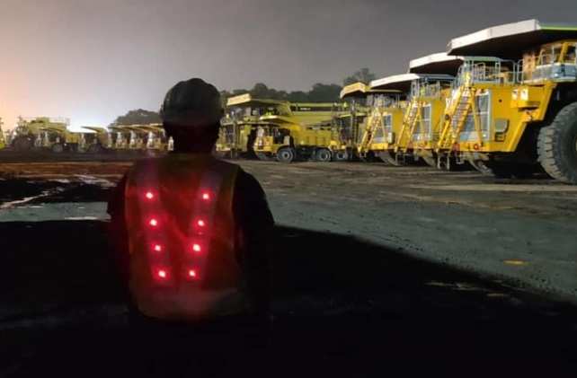
Thank You

